Slide 1
Presentation on the Alternative of Application(AOA) System Tshwane North TVET College 2025 AdaptIT User Group Conference

Slide 2
Title: Alternative of Application(AOA) System Improvements Subtitle: Enhancing the Application Process at Tshwane North TVET College Presented by: EPT Vilakazi Date: 10 March 2025

Slide 4
Introduction:
Overview of the Alternative of Application system.
Why the modification was necessary.
Collaboration with AdaptIT to improve system functionality.
Presentation created by Ms. EPT Vilkazi

Slide 5
Challenges Faced Before Modification:
Applicants bypassing critical sections.
Missing essential data such as disability status and required documents.
Incomplete applications affecting qualification selection and reporting accuracy.
Presentation created by Ms. EPT Vilkazi

Slide 6
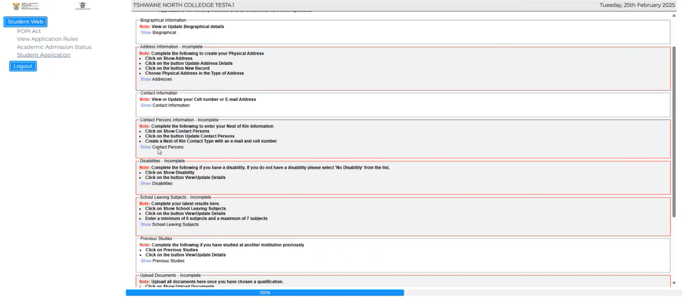
Key Modifications Implemented:
Mandatory Fields: Applicants must complete key fields (added features: Disability tab & document tab) before proceeding.
Presentation created by Ms. EPT Vilkazi

Slide 7
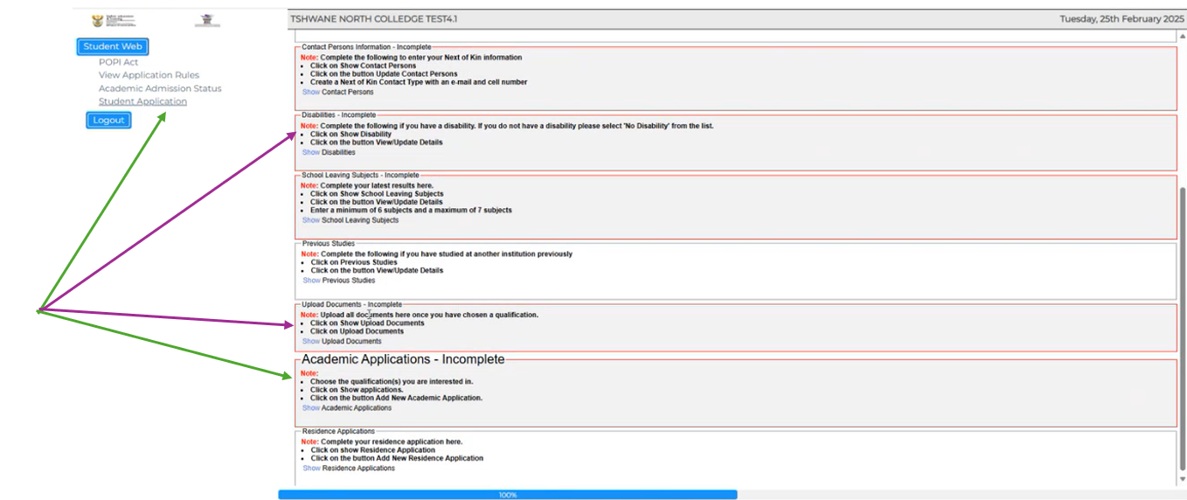

Slide 8
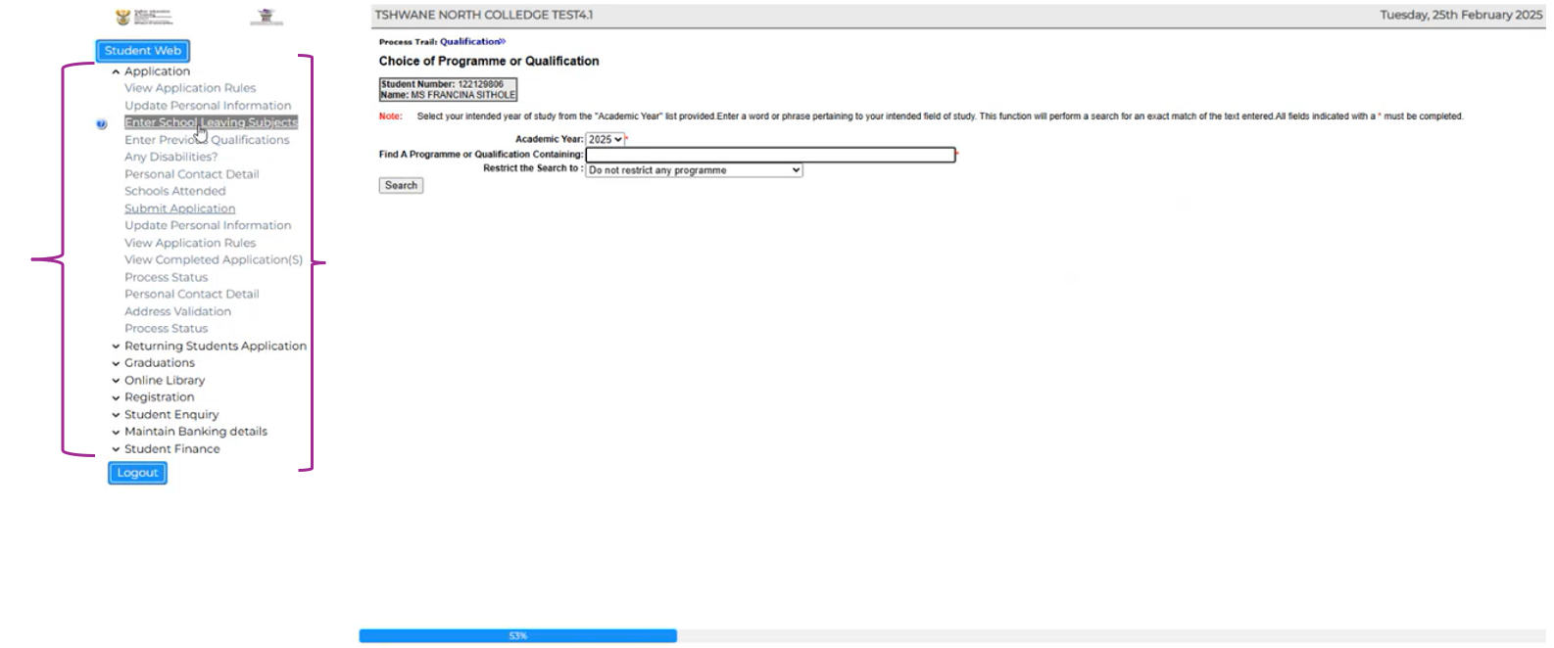

Slide 9
Enhanced Document Upload Process:
Ensures all required documents are submitted before qualification selection .
.

Slide 10
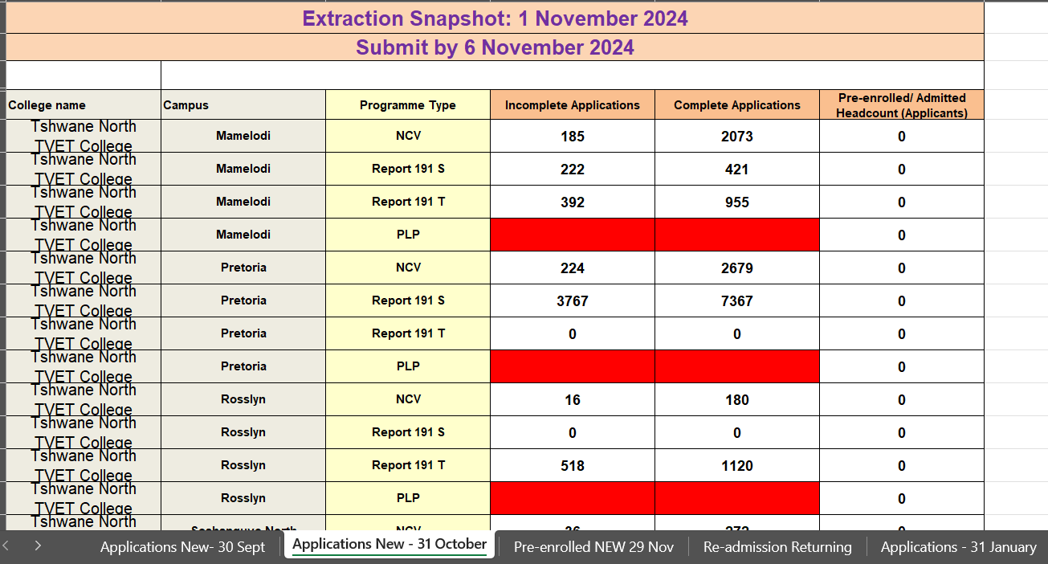
Impact on Reporting and Compliance:
Enhanced Application Snapshots:
Improved reporting capabilities as per DHET enrolment SOP requirements.
Ability to track complete and incomplete applications.
Presentation created by Ms. EPT Vilkazi

Slide 11
Automated Status Allocation:
Running GWEBM-9 automatically assigns statuses to applicants based on document uploads and Not loaded.

Slide 12
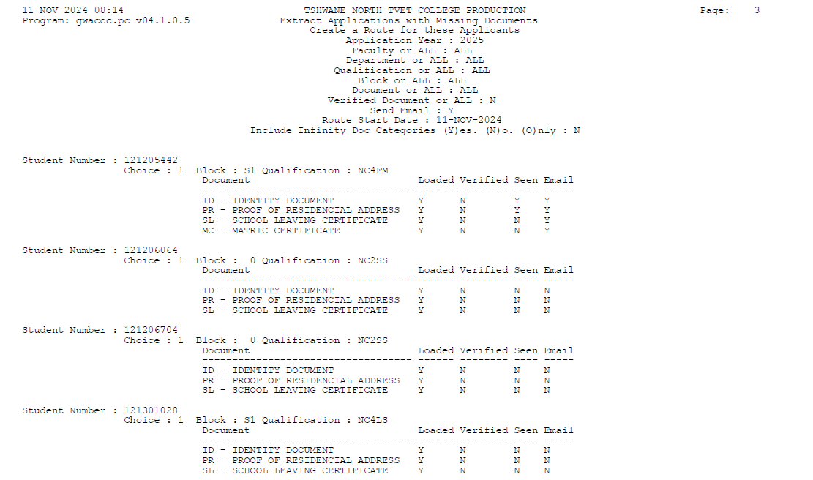
Presentation created by Ms. EPT Vilkazi

Slide 13
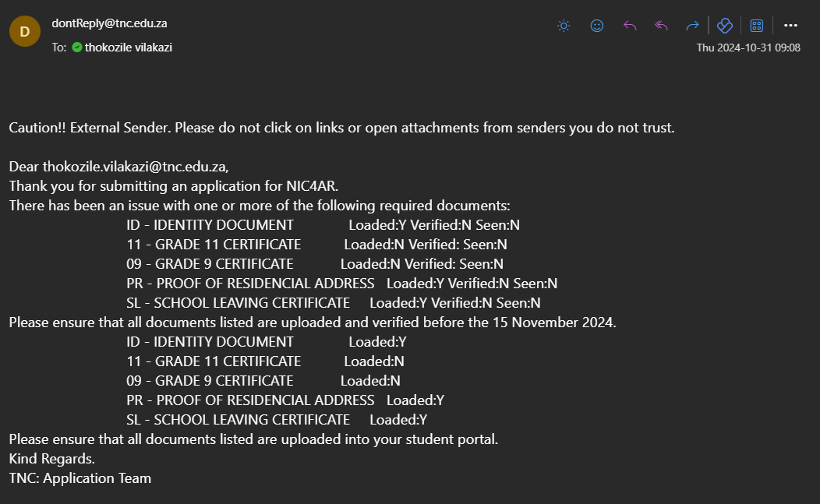
3. Email Notifications for Incomplete Applications: Automatic reminders sent to applicants who haven't uploaded documents.
Email:
Presentation created by Ms. EPT Vilkazi

Slide 14
Benefits of the Modified System:
✅ More accurate and complete application data.
✅ Ensures compliance with DHET reporting standards (Enrolment SOP).
✅ Streamlined application process for both applicants and administrators.
✅ Reduces manual follow-ups by automating status allocation and email reminders
Presentation created by Ms. EPT Vilkazi

Slide 15
Presentation created by Ms. EPT Vilkazi

Slide 16
Presentation created by Ms. EPT Vilkazi

